Slide 1
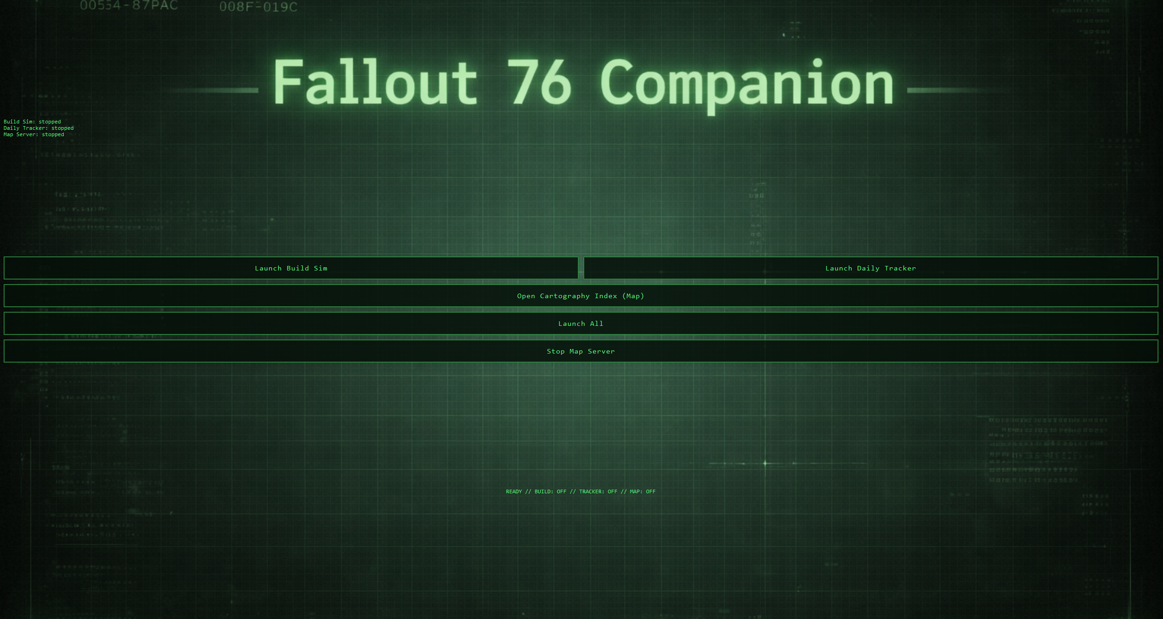
James Wood

Slide 2
Purpose
Augment the player experience while they engage with Fallout 76 systems.
Reduce friction of in game systems and ease the burden daily engagements.
Provide a single application that makes hidden or fragmented information visible and structured.

Slide 3
Three Subsystems:
Build Simulator – Solves build decision visibility.
Cartography Index – Removes lookup friction.
Activity Tracker – Solves time visibility.
Notes:
Build Simulator – Current in game systems require you navigate between multiple screens constantly, never seeing the full picture of your build.
Cartography Index – Current systems such as daily quests and challenges or in game events require you to find so many of x item. Or hunt down this many of x creatures. Without just knowing where these things are, you often resort to looking up online where to find them. The index allows you to start tracking your finds along your adventure, providing an easy visible reference on where to find things or creatures when needed.
Activity Tracker – Fallout 76 has three separate time gates and no in game indication of their status. You have daily reset, weekly reset, and last completion timer. Depending on the event, each timer may interact differently. The activity tracker aims to provide a method of tracker that is easily visibly alongside a map overview to plan daily activities.

Slide 4
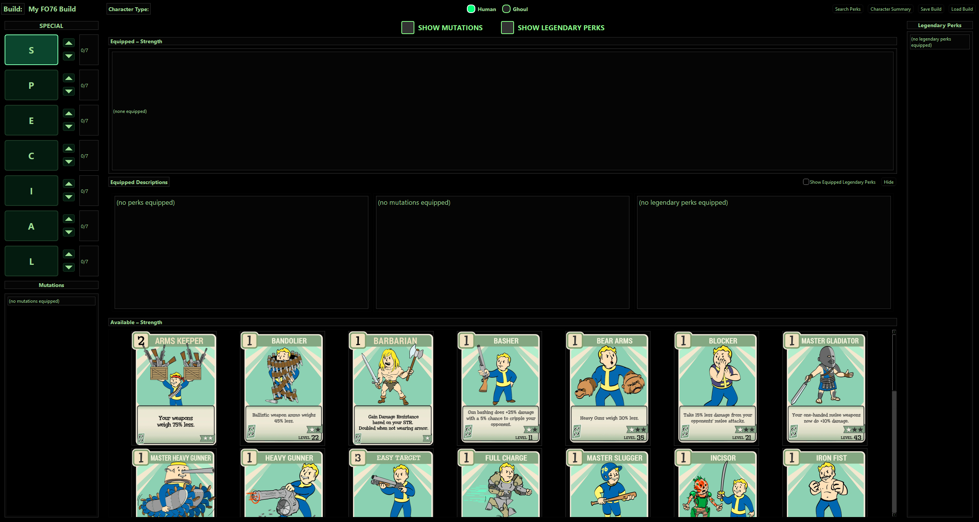
Build Simulator Demo

Slide 5
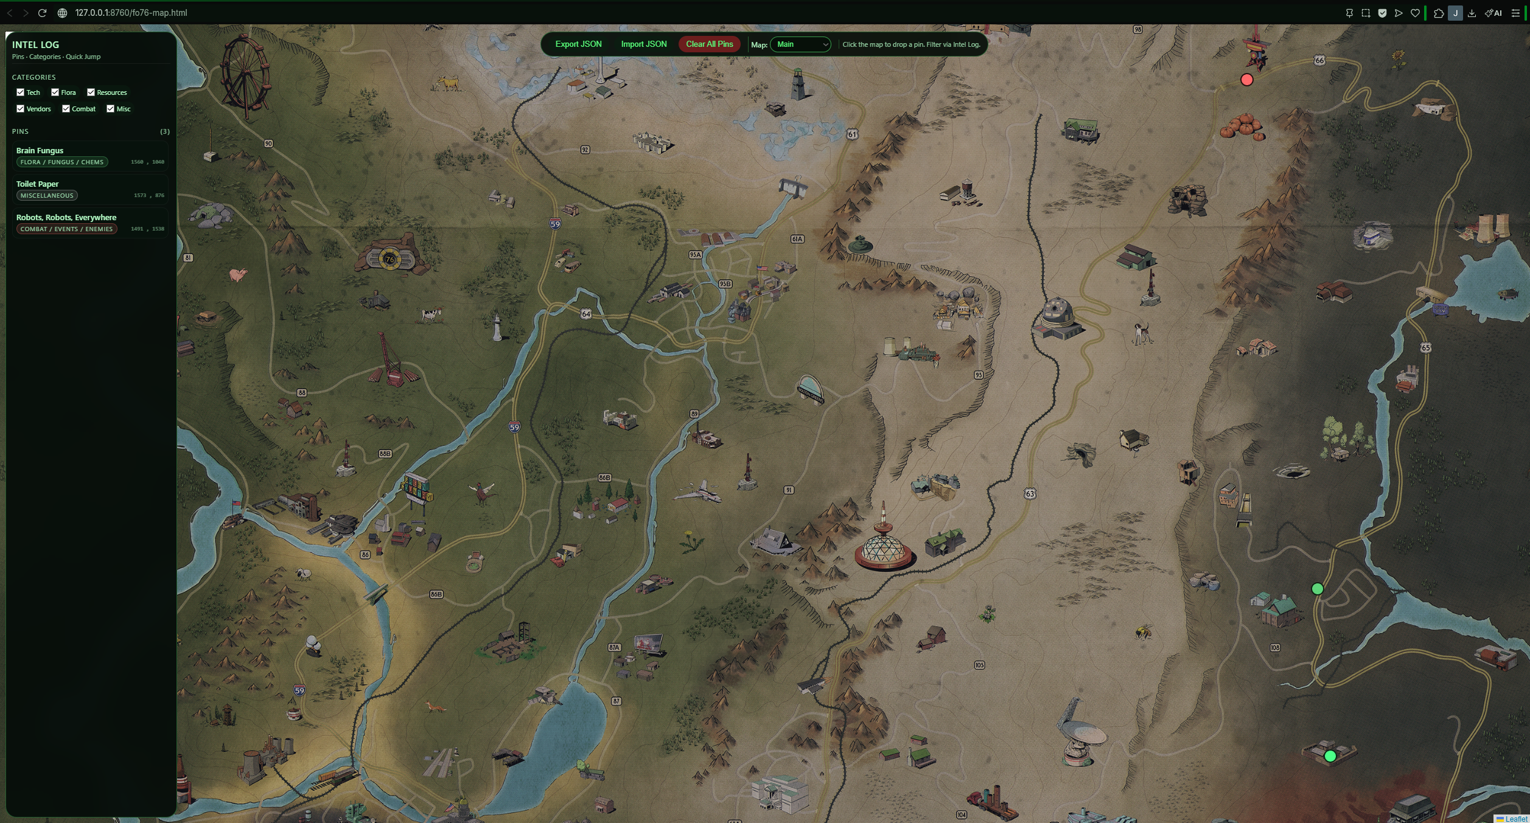
Cartography Index Demo

Slide 6
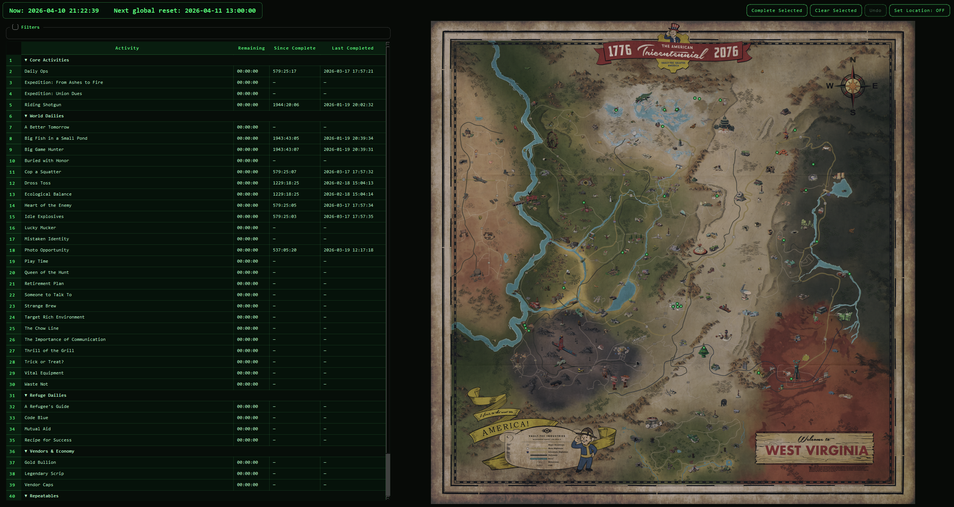
Activity Tracker Demo

Slide 7
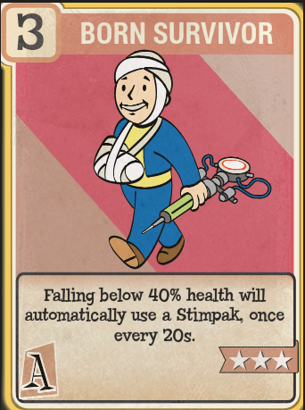
Challenges
Map coordinate normalization
Constraint validation (build sim)
Mixed architecture (HTML vs PySide)
UI balance (function vs immersion)

Slide 8
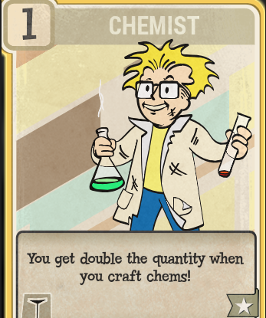
Future Enhancements
UI standardization
Improved Map Interaction and Editing

Slide 9
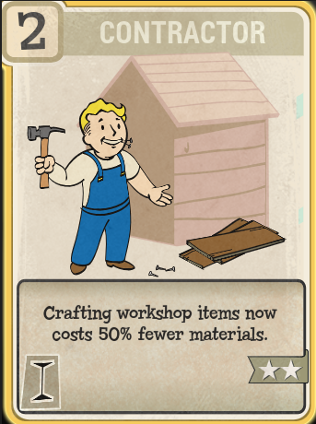
References & Attributions
Bethesda Game Studios
  Fallout 76 is a trademark of Bethesda Game Studios. All related artwork and assets are the property of Bethesda and are used in this project for educational, non-commercial purposes.
ChatGPT
  This project used images generated by OpenAI’s ChatGPT to provide visual representation for character mutations.
  OpenAI. (2026). ChatGPT (GPT-5) [Large language model]. https://chat.openai.com/

Slide 10
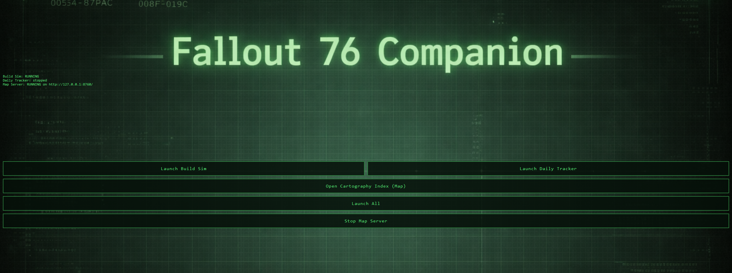
Conclusion
At the core of this project it was all about visibility and turning systems that normally have you guess, recall, or reference into something you can actually see and act on.

